Slide 1

Project Task
(4-5 members per group)
Artificial Intelligence
School of Computing
Universiti Teknologi Malaysia

Slide 2
Mark Distribution: Assignment & Project
No. | Assessment | PLO2 (C2) | PLO4 (C3B) | Total (%)
 |  | CLO2 | CLO3
1 | Assignment 1 | 5 |  | 5
2 | Assignment 2 | 5 |  | 5
3 | Assignment 3 | 5 |  | 5
4 | Project Generic Skills |  | 10 | 10
5 | Project | 10 |  | 15
Total (%) |  | 25 | 10 | 35

Slide 3
Outline
Mark Distribution
The theme
Mapping Task Assessment
Design Thinking
Project Timeline & Grading
Project: Design Thinking oriented proposal (Week 4)
Progress 1 – Assignment 1 (Week 5)
Progress 2 – Assignment 2 (Week 9)
Progress 3 – Assignment 3 (Week 12)
Project: Proof of Concept (Due: Week 14)
Notes:
https://data-flair.training/blogs/heuristic-search-ai/

Slide 4



The Theme
The project is aimed to provide innovative solution that improve current established system, or a new unprecedented solution based on real-world problem (according to theme) by implementing artificial intelligence (AI). The assignment and project task will reflect the three major components in AI:
Knowledge representation
State space search
Intelligent AI
You will develop a prototype as a proof of concept implementation of an intelligent application (can be in mobile application / web application). Design thinking will be used as a design methodology for you to develop this prototype.
THEME: HEALTHCARE, AGRICULTURE, SMART EDUCATION, SMART CITY, SENTIMENT ANALYSIS
GROUP STRUCTURE: 4-5 MEMBERS
ASSESSMENT SKILL: PROBLEM SOLVING & TEAMWORKING

Slide 5
Mapping Task Assessment
No. | Assessment | Task | Problem Solving (PLO3, CLO2) | Teamwork (PLO8, CLO3) | Total (%)
1 | Project: Proposal | Proposal that defines: AI solution The goal of AI solution Describe the process of Emphatize in DT Describe the process of Define in DT | 2 |  | 6
 | Assignment 1 | Describe Ideate process in DT by proposing: Relevant knowledge representation that supports AI solution to achieve the goal | 3 | 1 (Peer assessment)
2 | Assignment 2 | Describe Ideate process in DT by formulating: Using state space search that supports the previous defined knowledge representation to achieve the goal | 5 | 2 (Peer assessment) | 7
3 | Assignment 3 | Describe Ideate process in DT by formulating: Using PEAS model representation that supports AI solution to achieve the goal | 5 | 2 (Peer assessment) | 7
4 | Project: Prototype | Describe Prototype process in DT by developing: Proof of concept of AI solution | 10 | 5 (Peer assessment) | 15
TOTAL |  |  |  |  | 35

Slide 6
What is Design Thinking?
Definition & Process
Use Design Thinking to brainstorm ideas to solve real world problems

Slide 7
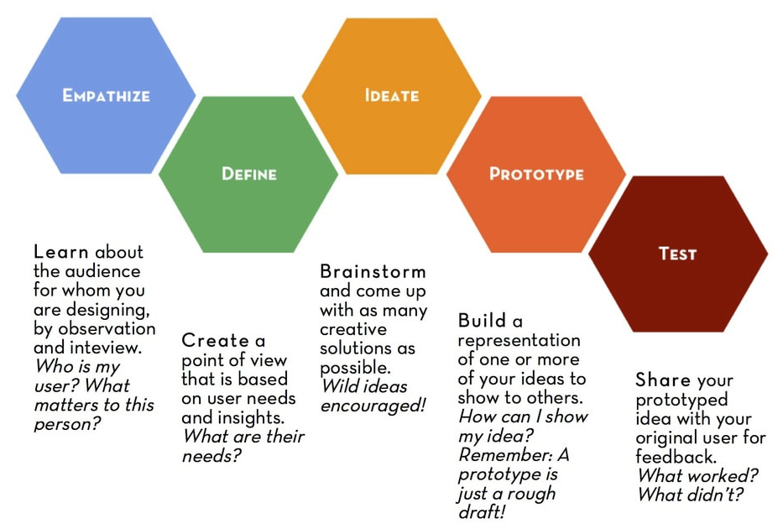
Design Thinking Process
1. Empathize with the users and discover their pain
2. Define user needs and requirements
3. Ideate solutions using AI
4. Prototype your ideas into POC

Slide 8
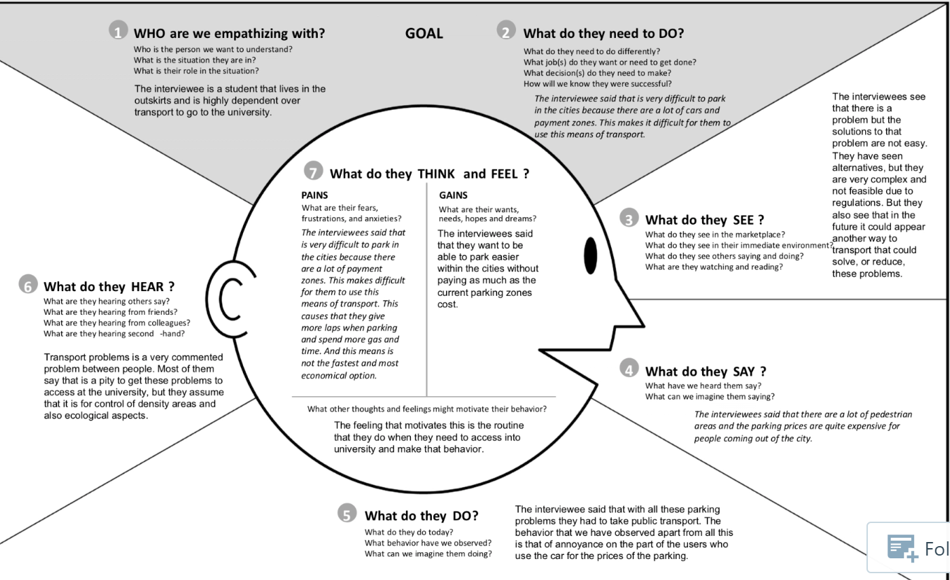
Examples of question in Empathy for DT process

Slide 9
Project Timeline & Grading
3% - CLO2
1% - CLO3*
1. Progress 1 (Asg1)
Due: Week 5
2% - CLO2
5% - CLO2
1. Design Thinking oriented Proposal
Due: Week 4
2. Progress 2 (Asg2)
Due: Week 9
2% - CLO3*
10% - CLO2
4. Proof of Concept (POC)
Due: Week 14
5% - CLO2
3. Progress 3 (Asg3)
Due: Week 12
5% - CLO3*
2% - CLO3*
CLO3* - peer review/self review on TW

Slide 10
Project: Design Thinking oriented Proposal
2% CLO2

Slide 11
CLO2: Design Thinking oriented Proposal – 2%
The project is aimed to provide innovative solution that improve current established system, or a new unprecedented solution based on real-world problem (according to theme either healthcare, agriculture, smart city and smart education) by implementing AI.
Use Design Thinking (DT) to discover AI solutions to a real-world problem
Answer how the AI solution can achieve the aim/objective of the proposed product/system/software/apps
Formulate your solution and describe it in parts following the Design Thinking Process diagram
The proposal should comprise at least as follows:
AI solution
The goal of AI solution
Describe the process of Emphatize in DT
Describe the process of Define in DT

Slide 12
Rubric: Design Thinking oriented Proposal (2%)
Category | 4 | 3 | 2 | 1 | Score?
Elaboration of emphatize | Problem and pain, user/stakeholder and the goal are clearly described. | Problem and pain, user/stakeholder and the goal are somehow clearly described. | Problem and pain, user/stakeholder and the goal are limited described. | Problem and pain, user/stakeholder and the goal are unclear described.
Elaboration of Design | Covers user/stakeholder needs in-depth with details and examples. | Includes essential user/stakeholder needs. | Includes essential user/stakeholder needs but there are 1-2 factual errors. | User/stakeholder needs is minimal OR there are several factual errors.
AI solution & goal | AI solution shows large amount of original thought. Ideas are creative and inventive. | AI solution shows some original thought. Work shows new ideas and insights. | AI solution uses other people’s idea (giving them credit) but there is little evidence of original thinking. | AI solution uses other people’s ideas but does not give them credit.

Slide 13
Checklist: Activity, PIC & Timeline
Task: Design thinking oriented proposal
Task | Description | PIC | Deadline
Describe the process of Empathize in DT
Describe the process of Define in DT
The goal of AI solution
AI solution

Slide 14
Checklist: Activity, PIC & Timeline
Task: Design thinking oriented proposal
Task | Description | PIC | Deadline
Describe the process of Emphatize in DT | Problem and pain, user/stakeholder and the goal are clearly described. Who is my user? What matters to them?
Describe the process of Define in DT | Covers user/stakeholder needs in-depth with details and examples. What are their needs?
The goal of AI solution | AI solution shows large amount of original thought. Ideas are creative and inventive.
Name AI solution

Slide 15
Examples of question in Empathy for DT process

Slide 16
Progress 1 – Knowledge Representation
Assignment 1
3% CLO2, 1% TW

Slide 17
CLO2: Knowledge Representation – 3%
Propose the knowledge representation(KR) for your AI solution
Define at least FIVE KR using logical representation
A detailed write up on the KR
Explain how the KR supports the proposed AI solution to achieve the goal
Use FOL to describe the KR
Use appropriate connectives
Answer what KR is involved in order to achieve the aim/goal of the proposed product/system/software/apps

Slide 18
Rubric: Knowledge Representation (3%)
Category | 4 | 3 | 2 | 1 | Score?
Correctness of semantics | AI solution is clearly represented using natural language and FOL with correct semantic. | AI solution is somehow clear represented using natural language and FOL with some correct semantic. | AI solution is somehow clear represented using natural language and FOL with limited correct semantic. | AI solution is unclear represented using natural language and FOL with correct semantic.
Correctness of syntax | AI solution is clearly represented using a correct syntax of FOL. | AI solution is somehow clear represented using some correct syntax of FOL. | AI solution is somehow clear represented using limited correct syntax of FOL. | AI solution is unclear represented using a correct syntax of FOL.

Slide 19
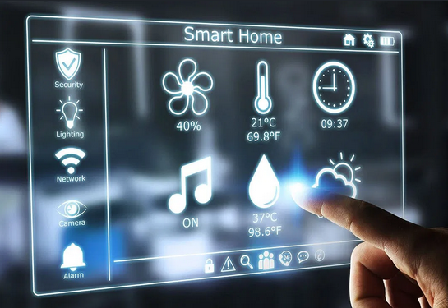
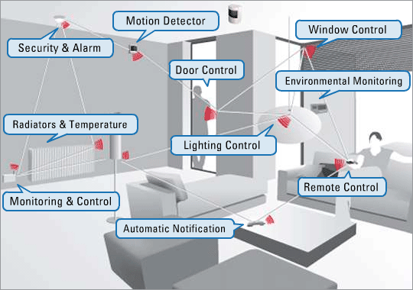
Example: SmartHome - Knowledge Representation
IF motion_detector = active AND door_control = on AND window_control = on THEN security_alarm = SET
IF lighting_control = off AND radiator = off OR temp=not_active THEN auto_notify = SET_FIRST_WARN

Slide 20
Rubric: Peer Review on TW (1%)
1% Peer review on Team Working (TW)
Rate each of your group member on Active Participation in the scale of 1 to 4
Category | 4 | 3 | 2 | 1
Active participation | Routinely provides useful ideas when participating in the group. | Usually provides useful ideas when participating in the group. | Sometimes provides useful ideas when participating in the group. | Rarely provides useful ideas when participating in the group.

Slide 21
Progress 2 – State Space Search
Assignment 2
5% CLO2, 2% TW

Slide 22
CLO3: State Space Search – 5%
Based on the previous KR, formulate the problem using state space search
Define the state space by specifying the states and actions
A detailed write up on the state space search
Explain each state and each actions
Represent the state space as graph (directed/undirected graph)
Formulate problem by specifying four things:
Initial state, Actions, Goal, Path cost
Solution: sequence of actions leading from initial state to goal state
Answer how the problem is formulated to support the proposed KR

Slide 23
Rubric: State Space Search (5%)
Category | 4 | 3 | 2 | 1 | Score?
Definition of state space graph | The goal, states, actions and path costs are clearly described. | The goal, states, actions and path costs are somehow clearly described. | The goal, states, actions and path costs are limited described. | The goal, states, actions and path costs are unclear described.
Correctness of state space graph | Represent precisely the problem using state space graph. | Represent somehow precisely the problem using state space graph. | Represent somehow precisely the problem using state space graph but there are 1-2 errors. | Represent so minimal the problem using state space graph OR there are several errors.

Slide 24
Rubric: Peer Review on TW (2%)
2% Peer review on Team Working (TW)
Rate each of your group member on Active Participation in the scale of 1 to 4
Category | 4 | 3 | 2 | 1
Active participation | Routinely provides useful ideas when participating in the group. | Usually provides useful ideas when participating in the group. | Sometimes provides useful ideas when participating in the group. | Rarely provides useful ideas when participating in the group.

Slide 25
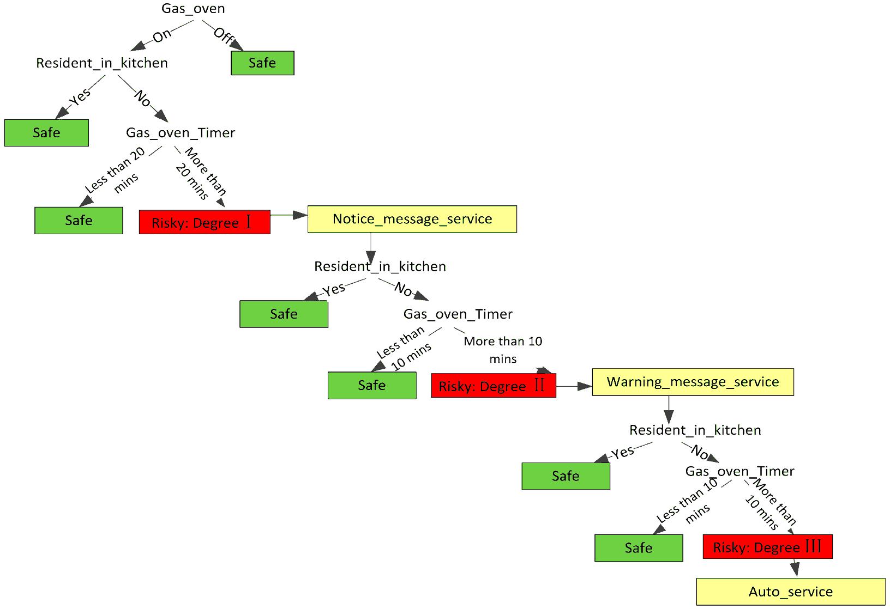
Example: SmartHome – State Space Search
Represent the problem formulation in a state space search
Here the goal for the system is to determine risk types and give appropriate response for such risks
Notes:
https://www.mdpi.com/1424-8220/16/8/1224/htm

Slide 26
Progress 3 – Intelligent Agent
Assignment 3
5% CLO2, 2% TW

Slide 27
CLO2: Intelligent Agent – 5%
Formulate the proposed AI solution using PEAS model representation
Define each property in PEAS model
A detailed explanation on each property
P: Performance measure
E: Environment
A: Actuators/Effectors
S: Sensors
Provide diagram(s) to represent the relations between each property
A write up on how each property will be represented in the Proof of Concept (POC)
Answer how agent in AI behaves in the proposed product/system/software/apps

Slide 28
Rubric: Intelligent Agent (5%)
Category | 4 | 3 | 2 | 1 | Score?
Definition of PEAS model | The performance measures, environment, actuators/effectors and sensors are clearly described. | The performance measures, environment, actuators/effectors and sensors are somehow clearly described. | The performance measures, environment, actuators/effectors and sensors are limited described. | The performance measures, environment, actuators/effectors and sensors are unclear described.
Correctness of PEAS model | Represent precisely the solution using PEAS model. | Represent somehow precisely the solution using PEAS model. | Represent somehow precisely the solution using PEAS model but there are 1-2 errors. | Represent so minimal the solution using PEAS model OR there are several errors.

Slide 29
Rubric: Peer Review on TW (2%)
2% Peer review on Team Working (TW)
Rate each of your group member on Active Participation in the scale of 1 to 4
Category | 4 | 3 | 2 | 1
Active participation | Routinely provides useful ideas when participating in the group. | Usually provides useful ideas when participating in the group. | Sometimes provides useful ideas when participating in the group. | Rarely provides useful ideas when participating in the group.

Slide 30
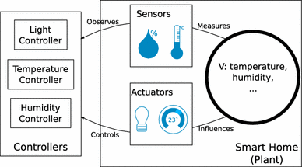
Example: SmartHome – Intelligent Agent
Along with detailed explanation on the above diagram
and how each property will be represented in the POC
Notes:
https://link.springer.com/article/10.1007/s40860-016-0020-z

Slide 31
Proof of Concept - POC
10% CLO2, 5% TW

Slide 32
CLO2: Proof of Concept – 10%
Develop a prototype as POC of the proposed AI solution
You may use any prototyping tools/software and it should include interactive interface. The main idea is for you to express your solution on how AI can be implemented in real-world problems.
To answer how the proposed AI solution can verify the concept in solving problems

Slide 33
Rubric: Proof of Concept (10%)
Category | 4 | 3 | 2 | 1 | Score?
Originality | POC shows large amount of original thought. Ideas are creative and inventive. | POC shows some original thought. Work shows new ideas and insights. | Uses other people’s idea (giving them credit) but there is little evidence of original thinking. | Uses other people’s ideas but does not give them credit.
Content organization | Content shows the most persuasive elements to attract reader. | Content shows the persuasive elements to attract reader. | Content shows minimal persuasive elements to attract reader. | Content shows the very minimal persuasive elements to attract reader.

Slide 34
Rubric: Proof of Concept (10%)
Category | 4 | 3 | 2 | 1 | Score?
Originality | POC shows large amount of original thought. Ideas are creative and inventive. | POC shows some original thought. Work shows new ideas and insights. | Uses other people’s idea (giving them credit) but there is little evidence of original thinking. | Uses other people’s ideas but does not give them credit.
Problem Formulation | Problem is clearly formulated and well explained with examples. | Problem is clearly formulated with adequate explanation. | Problem is somehow clear with limited explanation. | Problem is unclear.
Content organization | Content shows the most persuasive elements. | Includes essential knowledge about the topic. Subject knowledge appears to be good | Includes essential information about the topic but there are 1-2 factual errors. | Content is minimal OR there are several factual errors.

Slide 35
Rubric: Peer Review on TW (5%)
5% Peer review on Team Working (TW)
Rate each of your group member on Team Working Value in the scale of 1 to 4
Category | 4 | 3 | 2 | 1
Contributions | Routinely provides useful ideas when participating in the group. | Usually provides useful ideas when participating in the group. | Sometimes provides useful ideas when participating in the group. | Rarely provides useful ideas when participating in the group.
Problem-solving | Actively looks for and suggests solutions to problems. | Refines solutions suggested by others. | Does not suggest or refine solutions but is willing to try out solutions suggested by others. | Does not try to solve problems or help others solve problems. Let others do the work.
Attitude | Is never publicly critical of the project or the work of others. Always has a positive attitude about the task(s). | Is rarely publicly critical of the project or the work of others. Often has a positive attitude about the task(s). | Is occasionally publicly critical of the project or the work of other members of the group. Usually has a positive attitude about the task(s). | Is often publicly critical of the project or the work of other members of the group. Is often negative about the task(s).
Focus on the task | Consistently stays focused on the task and what needs to be done. Very self-directed. | Focuses on the task and what needs to be done most of the time. Other group members can count on this person. | Focuses on the task and what needs to be done some of the time. Other group members must sometimes nag, prod, and remind to keep this person on task. | Rarely focuses on the task and what needs to be done. Lets others do the work.
Working with Others | Almost always listens to, shares with, and supports the efforts of others. Tries to keep people working well together. | Usually listens to, shares, with, and supports the efforts of others. Does not cause "waves" in the group. | Often listens to, shares with, and supports the efforts of others, but sometimes is not a good team member. | Rarely listens to, shares with, and supports the efforts of others. Often is not a good team player.

Slide 36
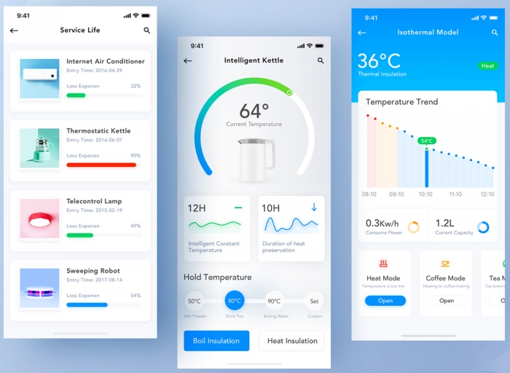
Example: SmartHome – Proof of Concept
Must be an interactive design to demonstrate the
concept of the proposed AI solution
Notes:
https://link.springer.com/article/10.1007/s40860-016-0020-z

